Slide 1

Geometry
Unit 5, Lesson 4 Exploring Corresponding Parts of Congruent Triangles That Are Congruent Volume 1, pg. 241

Slide 2


Benchmarks
MA.912.GR.1.6 Solve mathematical and real-world problems involving congruence or similarity in two-dimensional figures.
MA.912.GR.2.3 Specify a sequence of transformations that will map a given figure onto itself, or onto another congruent or similar figure.
MA.912.GR.2.6 Apply rigid transformations to map one figure onto another to justify that the two figures are congruent.
volume 1, pg. 241

Slide 3
Integrated Mathematical Thinking and Reasoning Standards
MA.K12.MTR.1.1 Actively participate in effortful learning both individually and collectively.
MA.K12.MTR.2.1 Demonstrate understanding by representing problems in multiple ways.
MA.K12.MTR.3.1 Complete tasks with mathematical fluency.
MA.K12.MTR.4.1 Engage in discussions that reflect on the mathematical thinking of self and others.
MA.K12.MTR.5.1 Use patterns and structure to help understand and connect mathematical concepts.
volume 1, pg. 241

Slide 4

Learning Targets
I can relate the definition of congruence in terms of rigid motions to corresponding parts of congruent triangles.
I can use corresponding parts of congruent triangles to write congruence statements.
volume 1, pg. 241

Slide 5

Warm-Up
volume 1, pg. 241

Slide 6
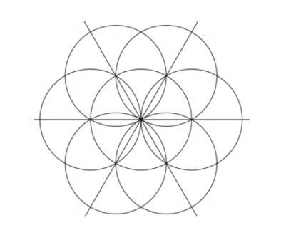
5.4.1 Warm-Up: Art in Geometry
Salih is taking an art class that looks at the different patterns in tiles from across the world. Salih used a compass to create this first step in a 12-fold pattern.
What do you notice about the design?
volume 1, pg. 241

Slide 7
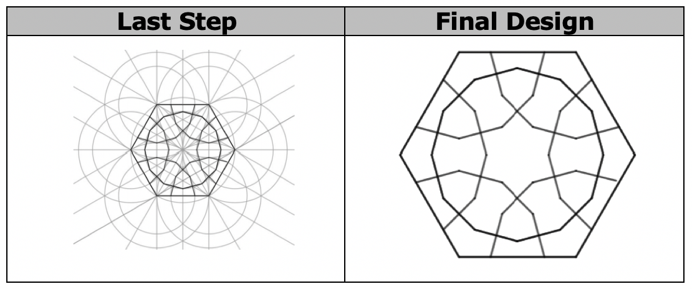
The last step of the 12-fold pattern and the final design are shown.
What do you wonder about the pattern or the final design?
volume 1, pg. 241

Slide 8

Collaboration
volume 1, pg. 242

Slide 9

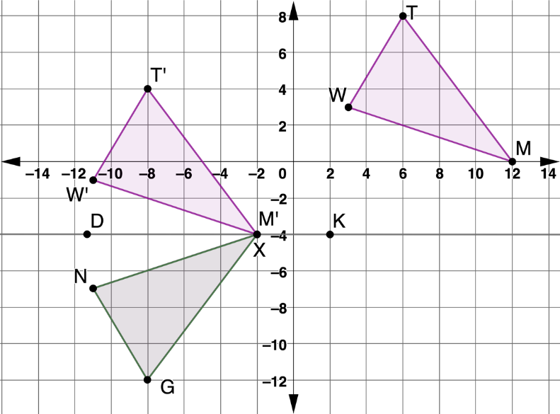
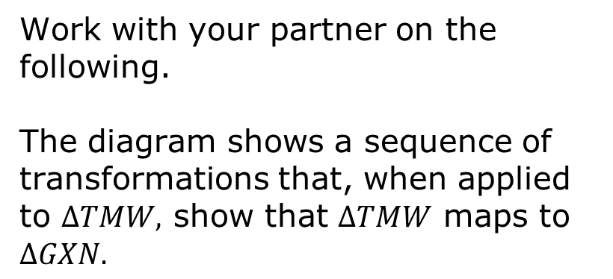
5.4.2 Collaboration: Congruence in Terms of Rigid Motions
Work with your partner on the following.
The diagram shows a sequence of transformations that, when applied to $∆TMW,$ show that $∆TMW$ maps to $∆GXN.$
What are the transformations used to map $∆TMW$ to $∆GXN$?
volume 1, pg. 244

Slide 10

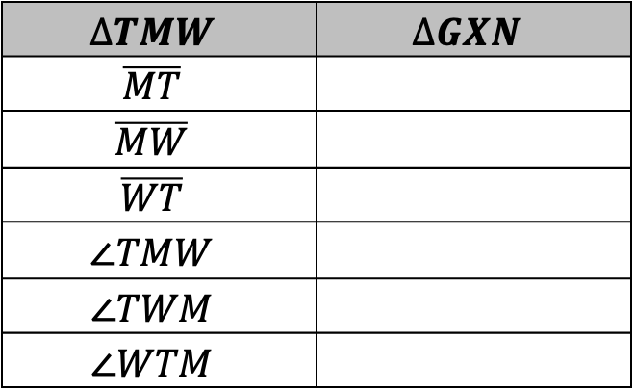
Complete the table by determining which parts of $∆GXN$ correspond with the given part of $∆TMW$ after mapping $∆TMW$ to $∆GXN.$
$$∆TMW$$ | $$∆GXN$$
$$\overline{MT}$$
$$\overline{MW}$$
$$\overline{WT}$$
$$∠TMW$$
$$∠TWM$$
$$∠WTM$$
Definition of Congruence in Terms of Rigid Motions
Two figures are congruent if and only if there exists one or more rigid motions, which will map one figure onto the other.
volume 1, pg. 242

Slide 11
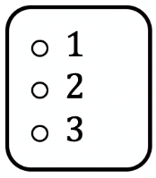
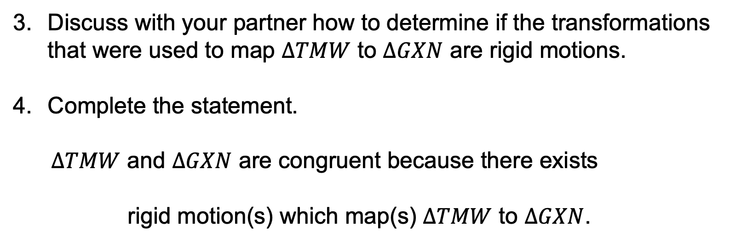
Discuss with your partner how to determine if the transformations that were used to map $∆TMW$ to $∆GXN$ are rigid motions.
Complete the statement.
$∆TMW$ and $∆GXN$ are congruent because there exists
rigid motion(s) which map(s) $∆TMW$ to $∆GXN$.
volume 1, pg. 242

Slide 12

Guided Instruction
volume 1, pg. 243

Slide 13
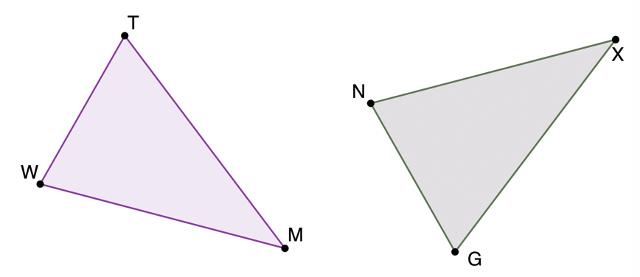
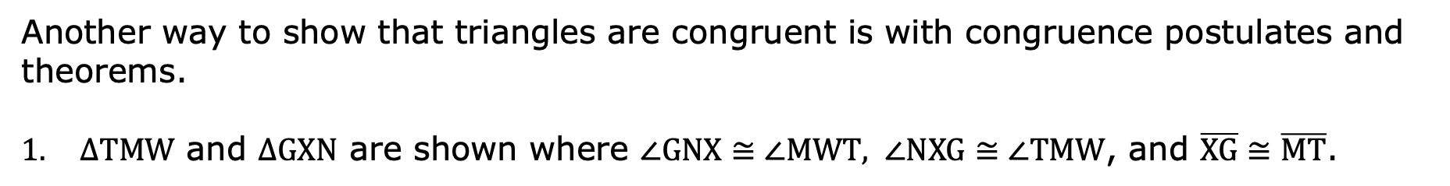
5.4.3 Guided Instruction: CPCTC
Another way to show that triangles are congruent is with congruence postulates and theorems.
$∆TMW$ and $∆GXN$ are shown where $∠GNX≅∠MWT, ∠NXG≅∠TMW$, and $\overline{XG}≅\overline{MT}$.
volume 1, pg. 243

Slide 14

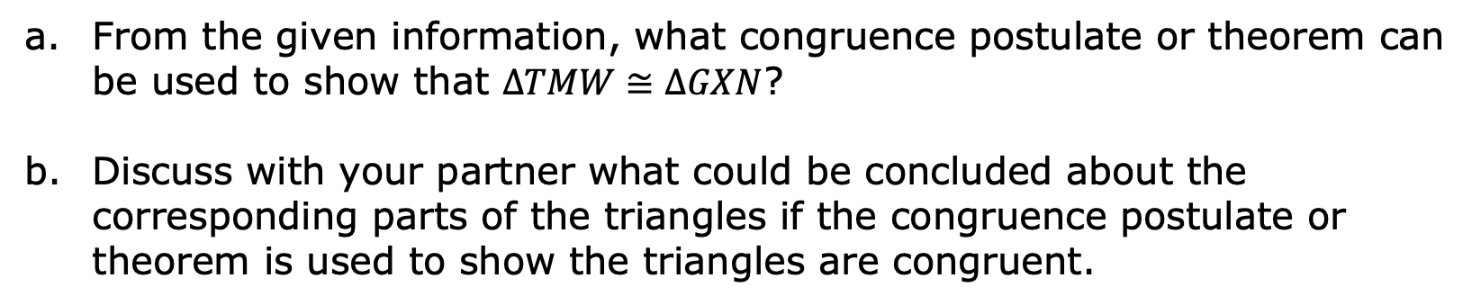
From the given information, what congruence postulate or theorem can be used to show that $∆TMW≅∆GXN$?
Discuss with your partner what could be concluded about the corresponding parts of the triangles if the congruence postulate or theorem is used to show the triangles are congruent.
Corresponding Parts of Congruent Triangles are Congruent (CPCTC)
Two figures are congruent if and only if there exists one or more rigid motions, which will map one figure onto the other.
There is a difference between naming two triangles and stating that two triangles are congruent. Order is important in a congruence statement, but is not necessary when only naming two triangles. The order used for congruence statements communicates which parts of the triangles correspond.
volume 1, pg. 243

Slide 15
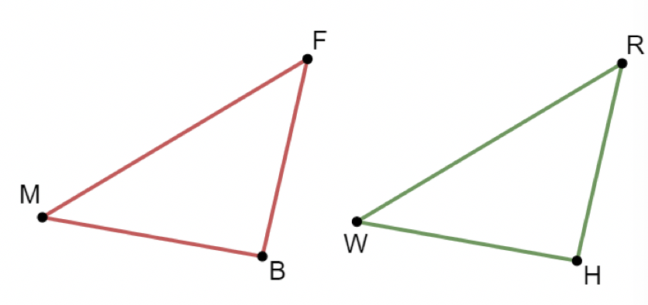
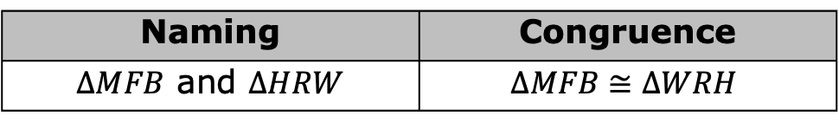
A diagram of two triangles is shown.
Naming | Congruence
$∆MFB$ and $∆HRW$ | $$∆MFB≅∆WRH$$
volume 1, pg. 244

Slide 16
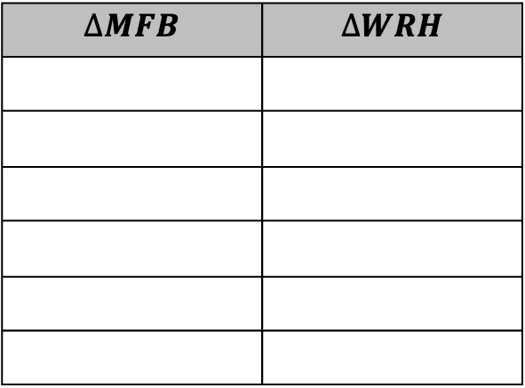
Use the congruence statement to name all of the corresponding parts of the triangles.
$$∆MFB$$ | $$∆WRH$$
volume 1, pg. 244

Slide 17
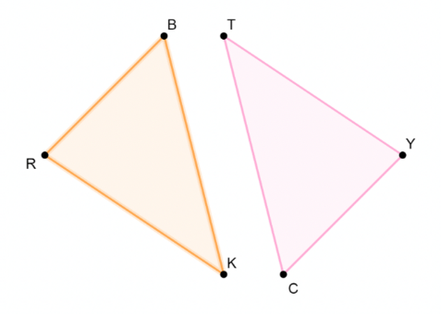
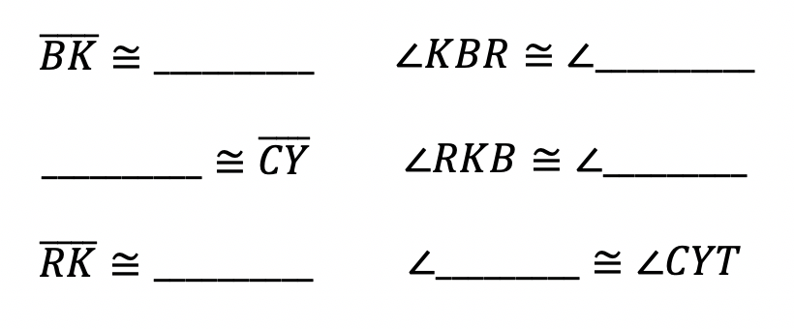
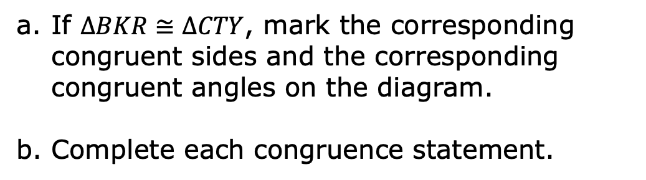
Consider triangles $BKR$ and $CTY$.
If $∆BKR≅∆CTY$, mark the corresponding congruent sides and the corresponding congruent angles on the diagram.
Complete each congruence statement.
volume 1, pg. 244

Slide 18
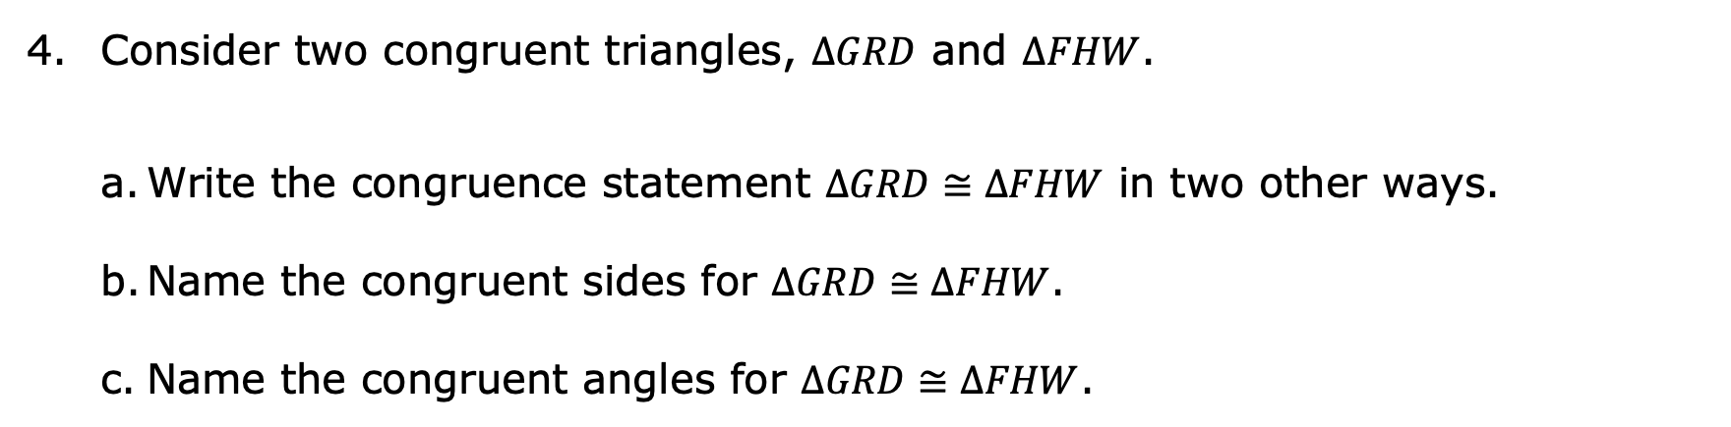
Consider two congruent triangles, $∆GRD$ and $∆FHW$.
Write the congruence statement $∆GRD≅∆FHW$ in two other ways.
Name the congruent sides for $∆GRD≅∆FHW$.
Name the congruent angles for $∆GRD≅∆FHW$.
volume 1, pg. 244

Slide 19
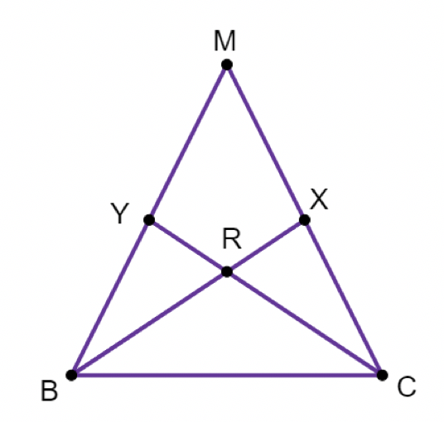
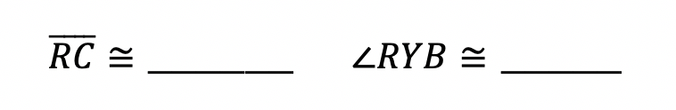
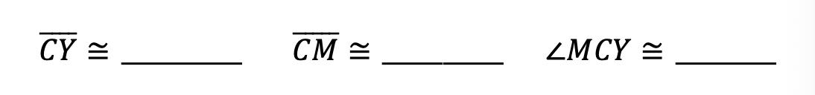
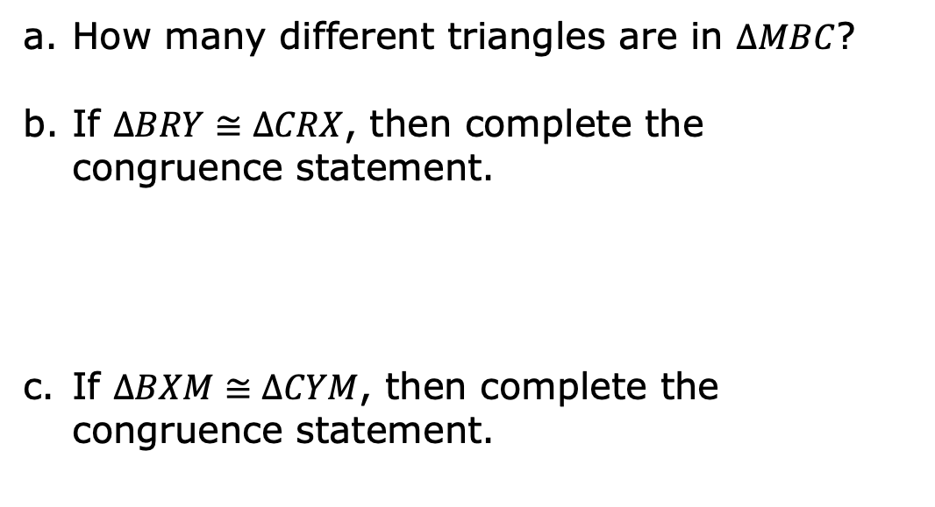
Triangle $MBC$ is shown.
How many different triangles are in $∆MBC$?
If $∆BRY≅∆CRX$, then complete the congruence statement.
If $∆BXM≅∆CYM$, then complete the congruence statement.
volume 1, pg. 245

Slide 20

Guided Practice
volume 1, pg. 245

Slide 21

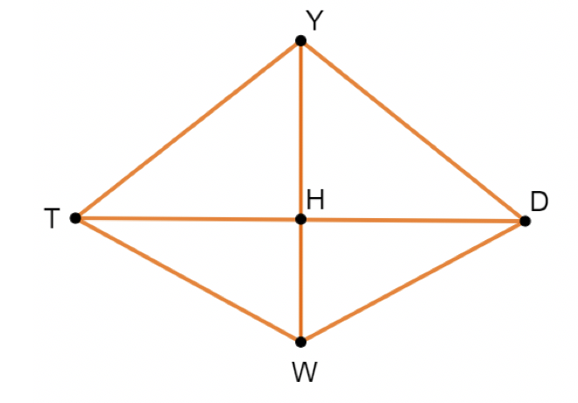
5.4.4 Guided Practice: Using CPCTC
Quadrilateral $YDWT$ is shown where $\overline{YH}$ is a perpendicular bisector of $\overline{TD}$.
How many different triangles are in Quadrilateral $YDWT$?
volume 1, pg. 245

Slide 22

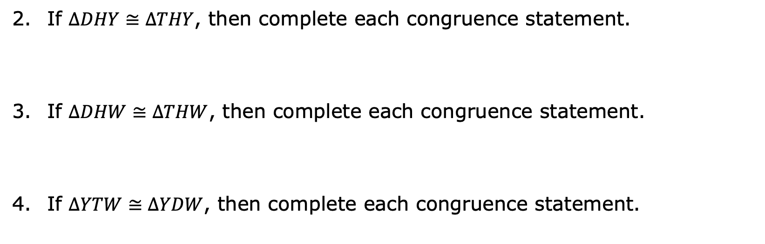
If $∆DHY≅∆THY$, then complete each congruence statement.
If $∆DHW≅∆THW$, then complete each congruence statement.
If $∆YTW≅∆YDW$, then complete each congruence statement.
volume 1, pg. 245

Slide 23

Wrap-Up
volume 1, pg. 246

Slide 24
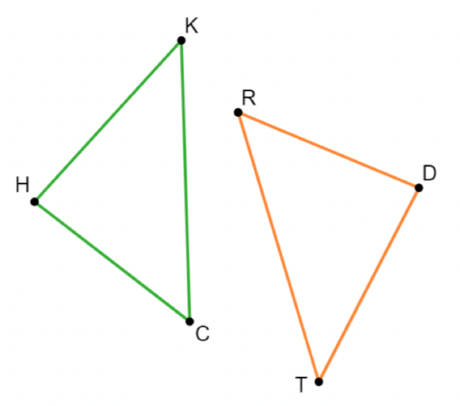
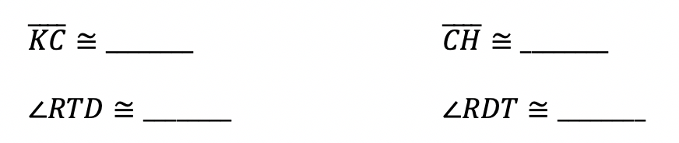

5.4.5 Wrap-Up: Cool Down
The diagram shows $∆HKC$ and $∆TDR$ where $∆HKC≅∆DTR$.
Complete each congruence statement.
volume 1, pg. 246

Slide 25
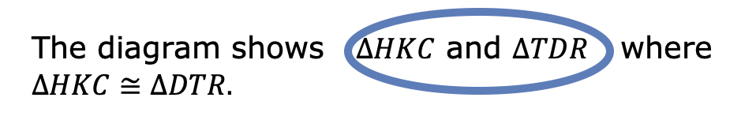
Becky told her teacher that there was a typo in the first sentence. She circled the typo.
Write a note to Becky explaining why this is NOT a typo.
volume 1, pg. 246

